Slide 1
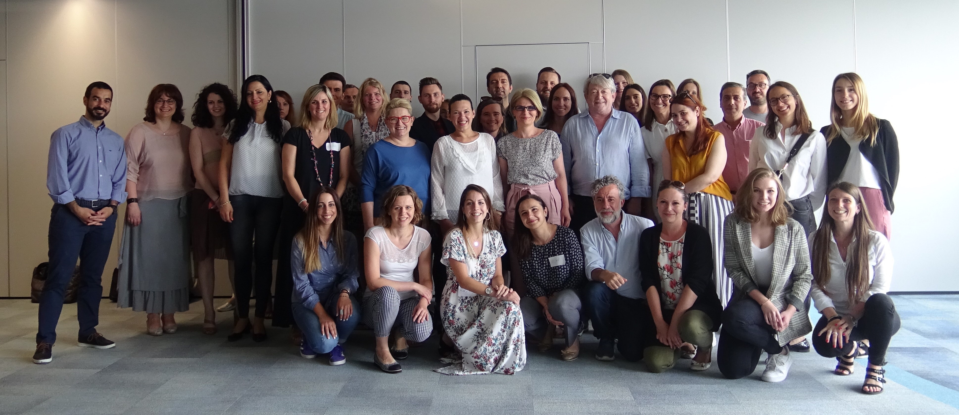
PRESENTATION OF REGIONAL FUNDS
Fund Operator:
Ecorys Polska & JCP Srl
28.06.2023
Notes:
The first photo was made during a communications workshop organized for the Active Youth projects in 2019

Slide 2
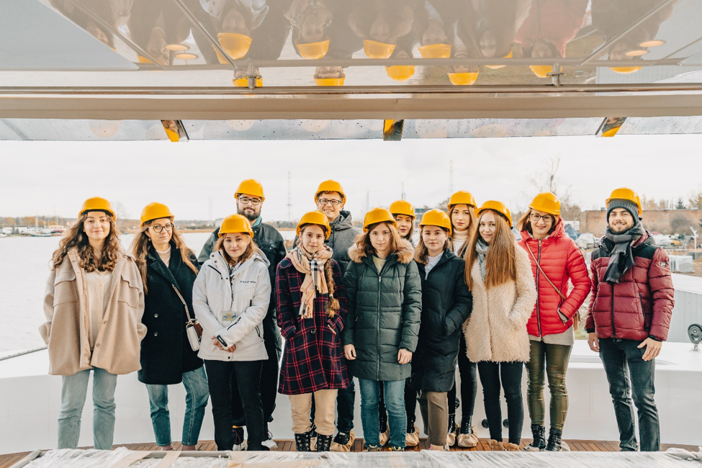
PROJECTS BY THEMES
Notes:
This photo was taken during one of the ‘Blue Generation’ courses, focusing on sustainable careers in blue economy in Greece, Spain, Portugal, Bulgaria and Poland with EPs from Belgium, Germany, Iceland and Norway. The project in its first phase reached to over 2 thousand young people and is currently continuing phase 2 under the restricted call.

Slide 3
INNOVATION, RESEARCH, EDUCATION AND COMPETITIVENESS
ENVIRONMENT, ENERGY, CLIMATE CHANGE AND LOW CARBON ECONOMY
  ZEVInnovation
  TBFVnet
  Wingate
  Uncorking rural heritage
  Circular-based waste management
  RF-YOUTH projects
  SUPMed
  EU-WATERRES
SOCIAL INCLUSION, YOUTH EMPLOYMENT
AND POVERTY REDUCTION
  BeeConSel
  Blue-Greenway
  New Solutions to Old Problems
  Inclusion through sports for children with developmental disabilities
  User4GeoEnergy
  Building momentum for the long-term CCS deployment in the CEE region
CULTURE, CIVIL SOCIETY, GOOD GOVERNANCE AND FUNDAMENTAL RIGHTS AND FREEDOMS
  COMPETENCE
  CODE Europe
JUSTICE AND HOME AFFAIRS
  Implementing shared anti-corruption and good governance solutions in Southeast Europe (…)
  HOPE - Holistic radicalisation Prevention initiativE
  Reclaim our Civil Space!
  The Portrait of a Judge
  2 PDPs (CoE & FRA)
Notes:
Here we see regional funds’ projects organised by thematic area.
RF-YOUTH is placed on the verge of the three areas: The main focus is obviously the youth employment, but the projects’ approaches contribute also to increased education and competitiveness and to green economy.

Slide 4
RESEARCH/POLICY ORIENTED
FOCUSED ON BLUE/GREEN/SUSTAINABLE JOBS
  Cowork4YOUTH
  Lost Millenials
  YouthPartnerSHIP
  Stay-ON
  RAISE Youth
  Blue Generation Project
  YouthSHARE
  Tr@ck-IN
  Youth Impact
  INTERCEPT
  Yenesis
  eNEET Rural
FOCUSED ON VULNERABLE GROUPS
FOCUSED ON ENTERPRENEURSHIP
  EURIBOR
  Direction Employment
  Women4IT
  NEETs in enterpreneurship
  YES!
  SOCIALNEET
  LEAD
  Find your way to the world of work
  FOLM
FOCUSED ON NEW SKILLS
  L.I.K.E.
  Mommypreneurs
  Migrant Talent Garden
  Young Service Steward Program
  Social Innovators
  SEPAL
  NESET
  Go remote!
  CODE
  IPS4NEETs
  DARE
  EDIBO
Notes:
RF-YOUTH projects all contribute to the overall goal of decreasing youth unemployment in Europe, but they vary in approaches taken.

Slide 5
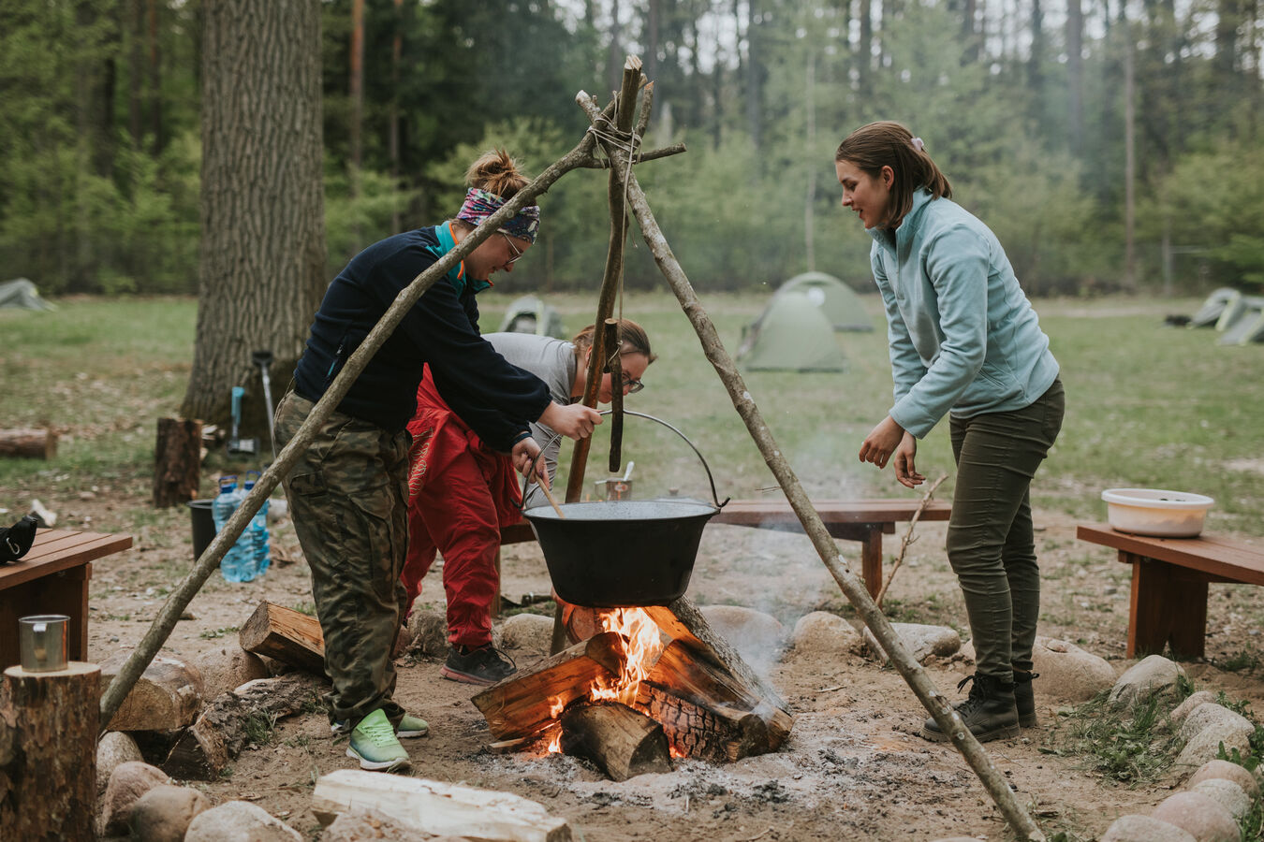
PARTNERS’ COUNTRY REPRESENTATION
Notes:
Photo is taken by FOLM project. The outdoor learning method was developed by EP (University of Edinbough) and adopted to the project, focusing on activisation of youth in Cantabria (Spain), Varmia and Mazuria (Poland) and Mid West (Ireland). The project served over 900 NEETs with motivational training in a natural setting, coaching and career advice. The method and policy recommendations have been appreciated by a network of stakeholders, who will continue to use it in their work with unemployed youth.

Slide 6
LEAD AND BENEFICIARY PARTNERS
31 BG
18 HR
15 CY
8 CZ
7 EE
30 EL
20 HU
7 IE
13 SI
25 non-EU
31 IT
13 LV
26 PL
17 PT
27 RO
8 SK
18 RO
6 MT
28 ES
EXPERTISE PARTNERS
37 NO
9 IS
37 EU
3 IO
Notes:
In bold are the Beneficiary States, from which the Lead Partners are eligible.
Noticeable high participation of entities from Italy and Spain in RF-YOUTH.
Beneficiary partners from neighboring countries: 5 from Albania, 5 from Bosnia, 5 from North Macedonia, 2 from Montenegro, 4 from Ukraine, 1 from Turkey and 1 from Russia (suspended).
The EU EPs include 4 entities from UK (eligible under Active Youth call).
The 3 IOs are: World Bank, ILO (International Labour Organization) and EPLO (European Public Law Organisation)
In terms of legal form, the PPs are very different with consortia often representing public, private and non-governmental sectors. A lot of NGOs obviously, but also universities and research institutions, private entities and local/regional authorities (even some ministries and national level public entities).

Slide 7
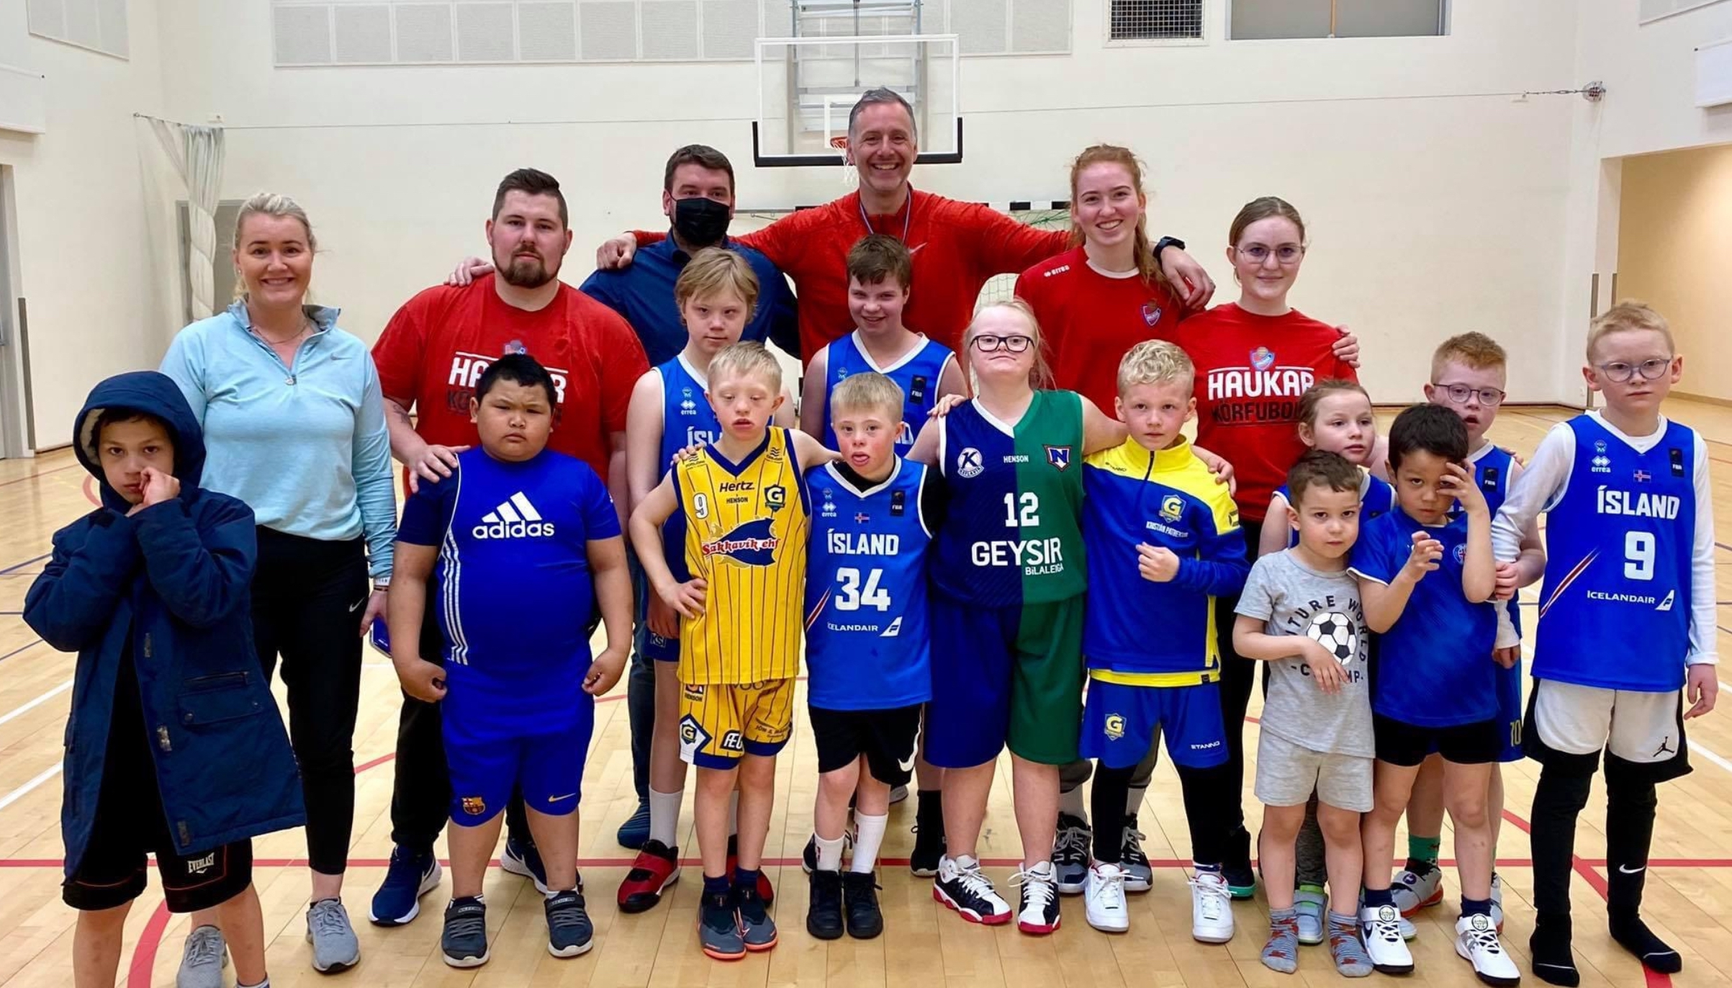
PROJECTS’ PROGRESS
Notes:
Photo from ‘Inclusion through sports’ project, which delivers outstanding outreach to children and their families across Europe.

Slide 8
OVERALL GOOD RESULTS
(many indicators overachieved)
VISIBLE PROGRESS AND GOOD QUALITY OUTPUTS
NO MAJOR THREATS TO IMPLEMENTATION
REAL IMPACT
RESILIENCE WHEN FACED WITH GLOBAL CHALLENGES
(Covid-19 pandemic, war in Ukraine)
Notes:
The staring point was different for projects under each call. The Active Youth has been probably most impacted by COVID, but projects have shown amazing resilience and, with FO support, endured.
For Common Challenges the selection process was probably the most difficult (as it was very competitive and quite lengthy). Once the projects started, they faced minor issues until the Russian aggression in February 2022. 3 projects were directly impacted (TBFVnet – Russian partner suspended and CBWM and EU-WATERRES with UA partners impacted). But several others also included Ukraine as territory of their activity, even if only via dissemination and knowledge sharing. And had to modify their plans (e.g. CODE Europe and abovementioned CSS4CCU).
The Unlocking… project started already in (post-)pandemic reality. What we noticed is that the one step procedure, lack of orientation sessions (because of the procedure and the restrictions), fully online onboarding after selection resulted in lesser personal connection between experts on the FO side and the project promoters. Which is difficult to create on a later stage. And requires more efforts on both sides to achieve common understanding.
Overall good results, the goals were mostly achieved. The few projects struggling a bit are under our close monitoring. The project promoters and active, engaged and highly motivated. We as FO see no major threats to the project implementation and achievement of planned results.

Slide 9
Project results
REPORTS
RESEARCH PAPERS
WORK MODELS
GUIDANCE AND INSTRUCTIONS
PLATFORMS
TRAINING MODULES
POLICY INFLUENCING
AWARENESS RAISING
TOOLKITS
CAPACITY BUILIDING
ATTITUDE CHANGING
Notes:
The projects, being so individual, bring a variety of tangible results (products). Reports, research papers, models, modules, platforms, toolkits etc. But more importantly they bring a change that is not immediate, and most often exceeds the project lifespan. This is their impact in terms of awareness raising, building capacity, changing attitudes and influencing policy. And this, we will hopefully witness in years to come as the regional funds contribute to the overall goals of the EEA and Norway Grants.

Slide 10

OUTSTANDING ACHIEVEMENTS
Notes:
Photo taken by Direction Employment project during one of the outreach campaigns (Lithuania). The project is an innovative training program for vulnerable young people, which enhances their employability in high-technology industries and the IT sector. The project operated (as it is coming to an end in March) in Bulgaria, Lithuania, Italy, Slovenia and Portugal. It targeted young people between the ages of 17 and 29, from different vulnerable groups - Roma, refugees, LGBTI people, young people growing up in extreme poverty and those who have dropped out of school.

Slide 11
Cross-project collaborations
Advocacy and lobbying
Awards and recognitions
„Let’s NEET together” series (SEPAL)
„Youth Forum” initiative (YES! & StayOn)
Knowledge exchange
New faculties / teaching programmes (Uncorking…, Social Innovators)
Joint articles in the MAGs
Memberships in networks and working groups
Presenting projects locally and internationally
Inclusive Entrepreneurship (YENESIS, 2022)
Crystal Wing (Inclusion through sports…, 2021)
Best practice by SHOUT (Social Innovators, 2021)
CEDEFOP recognition (YouthSHARE, 2021)
Joint proposals submitted for further collaboration
Studies/reseach papers utilised for policy making
Notes:
The presented are but a fraction of achievements outside of the basic scope of projects. As FO we’d like to think we had our part in those through encouraging the project promoters and enabling them in their pursuit of goals.
We are especially proud for the cross-project and also cross-funds collaborations. And in your final year of implementation, we will focus on further networking of the project promoters hoping to spark even more ideas.

Slide 12
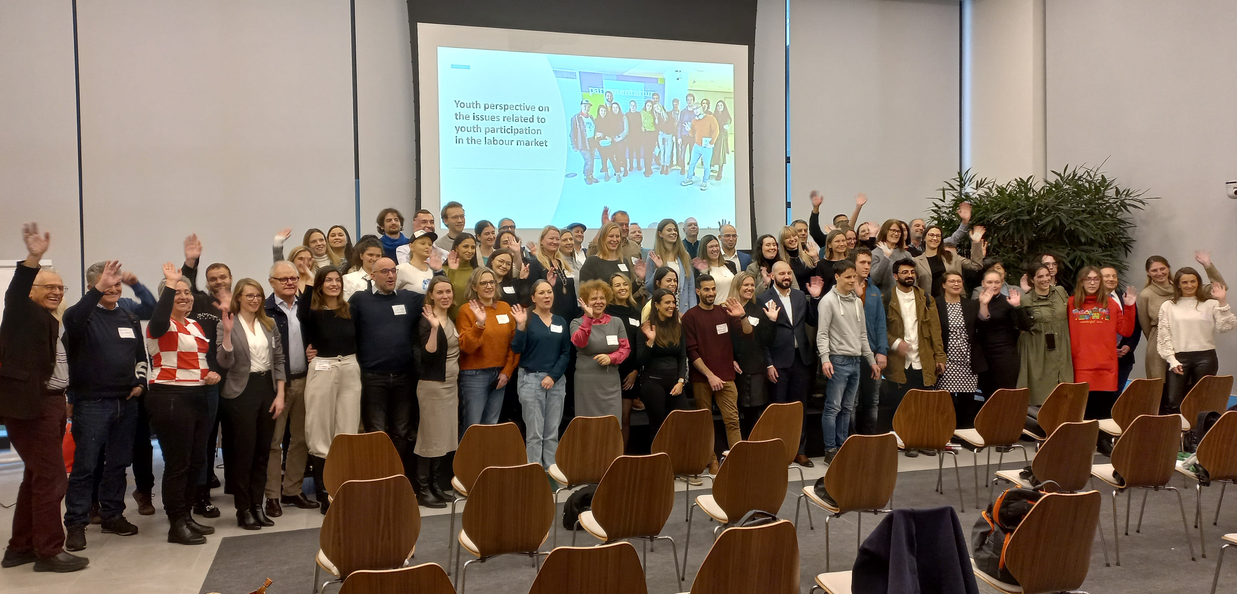
THANK YOU!
Notes:
Photo from Annual Seminar 2022 (Brussels, 13-14 December)
Having a bird’s-eye view on the projects may result with losing the humane perspective and seeing the projects as numbers: indicators achieved, target groups reached, grant spent… Obviously this is important for the FO, the FMO and the Donors. But I hope this presentation has also shown the people behind those numbers. First and foremost, the beneficiaries supported but also the amazing and dedicated project teams: the coordinators, facilitators, mentors, trainers, researchers and many more people working together to achieve the project goals.

